Slide 1
A Comparison of Predictive Intervals for Distribution-Free Regression Based on the paper “Distribution-Free Predictive Inference for Regression”, Lei Et al. 2017
STAT 501 Project – Jennie Hirsch – 12/7/2017
Under the direction of Dr. Nadeeshani Jayasena

Slide 2
Agenda
Introduction
Modeling Setup and Assumptions
Coverage Properties
Full Conformal Prediction Intervals
Split Conformal Prediction Intervals
Jackknife Conformal Prediction Intervals
Rank-One-Out Split Conformal Prediction Intervals
Additional Coverage Results
Simulations and R Package
Conclusion

Slide 3
Introduction
The purpose of this project is compare a few different prediction intervals for distribution-free regression. These methods are called conformal prediction, split conformal prediction, and jackknife prediction.
There is an increasing need for non-parametric and distribution-free regression. For example the growth in the tech sector creates demand for methods for extracting information from large high-dimensional data sets, with little starting knowledge about the distribution of the data. (2)
We present methods for constructing prediction intervals that do not assume a particular distribution of the data and are even valid if the model is not a good fit for the data.

Slide 4
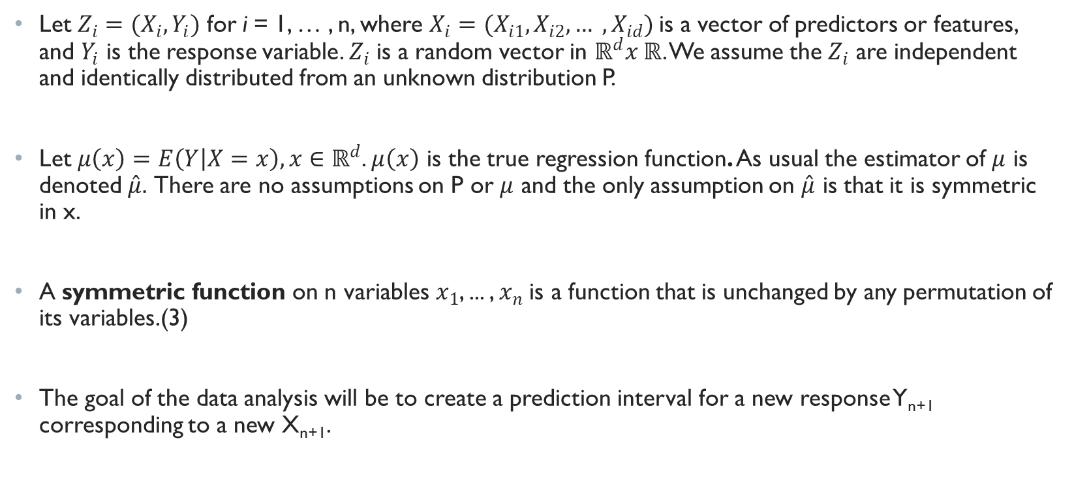
Modeling Set Up and Assumptions
Let $Z_{i}=(X_{i},Y_{i})$ for i = 1, … , n, where $X_{i}=(X_{i1},X_{i2}, … , X_{id})$is a vector of predictors or features, and $Y_{i}$ is the response variable. $Z_{i}$ is a random vector in $ℝ^{d}x ℝ$. We assume the $Z_{i}$ are independent and identically distributed from an unknown distribution P.
Let $μ\left(x\right)=E\left(Y | X=x\right), x∈ℝ^{d}$. $μ\left(x\right)$ is the true regression function. As usual the estimator of $μ$ is denoted $\hat{μ}.$ There are no assumptions on P or $μ$ and the only assumption on $\hat{μ}$ is that it is symmetric in x.
A symmetric function on n variables $x_{1}$, ... , $x_{n}$is a function that is unchanged by any permutation of its variables.(3)
The goal of the data analysis will be to create a prediction interval for a new response Y_{n+1} corresponding to a new X_{n+1}.

Slide 5
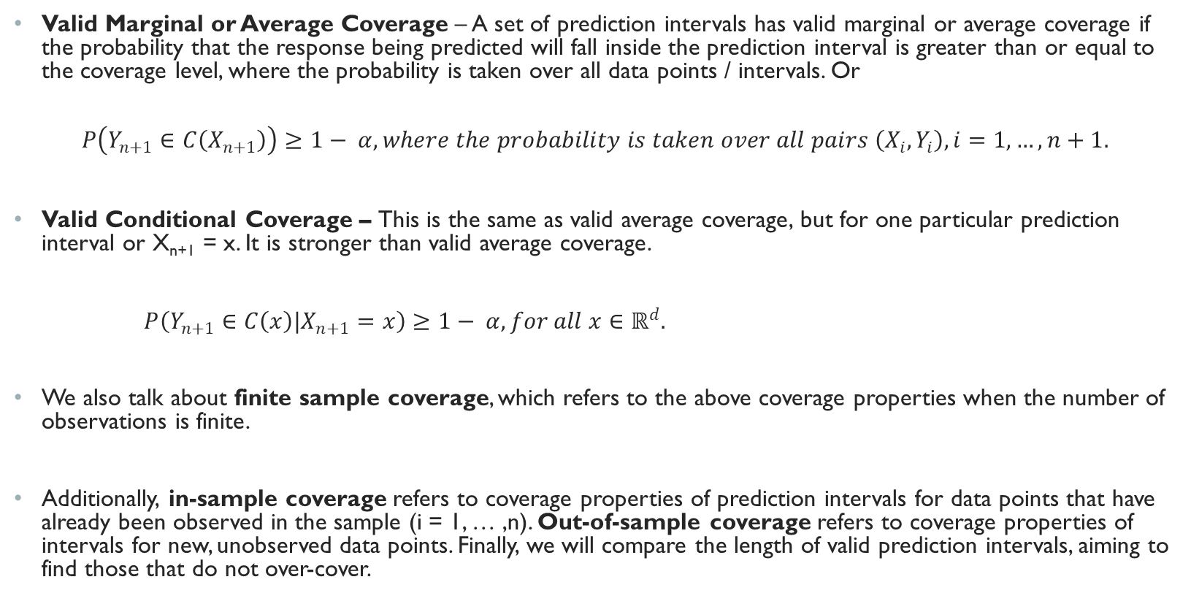
Defining Coverage properties
Valid Marginal or Average Coverage – A set of prediction intervals has valid marginal or average coverage if the probability that the response being predicted will fall inside the prediction interval is greater than or equal to the coverage level, where the probability is taken over all data points / intervals. Or
$$P\left(Y_{n+1}∈C\left(X_{n+1}\right)\right)≥1− α, where the probability is taken over all pairs \left(X_{i},Y_{i}\right), i=1, …, n+1.$$
Valid Conditional Coverage – This is the same as valid average coverage, but for one particular prediction interval or X_{n+1} = x. It is stronger than valid average coverage.
$P\left(Y_{n+1}∈C\left(x\right)|X_{n+1}=x\right)≥1− α, for all x∈ℝ^{d}.$
We also talk about finite sample coverage, which refers to the above coverage properties when the number of observations is finite.
Additionally, in-sample coverage refers to coverage properties of prediction intervals for data points that have already been observed in the sample (i = 1, … ,n). Out-of-sample coverage refers to coverage properties of intervals for new, unobserved data points. Finally, we will compare the length of valid prediction intervals, aiming to find those that do not over-cover.
Notes:
These are definitions as they are used in the original paper.
C is used to denote the prediction interval.

Slide 6
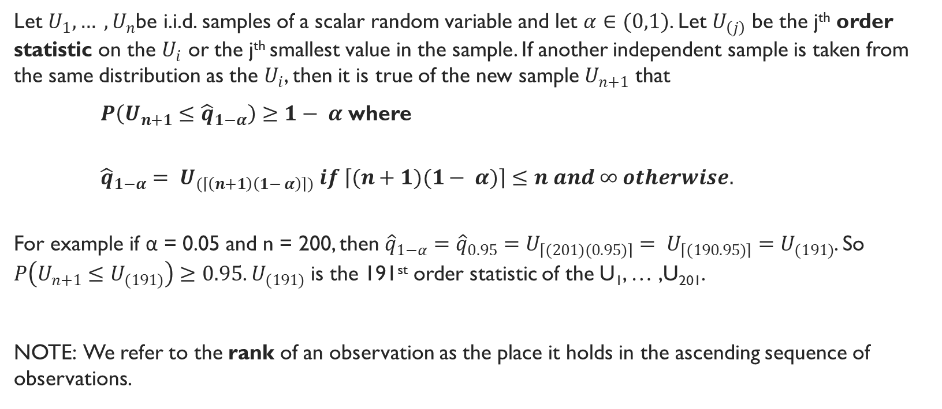
Preliminary Result (*)
Let $U_{1}, … , U_{n}$be i.i.d. samples of a scalar random variable and let $α∈(0,1)$. Let $U_{\left(j\right)}$ be the j^{th} order statistic on the $U_{i}$ or the j^{th} smallest value in the sample. If another independent sample is taken from the same distribution as the $U_{i}$, then it is true of the new sample $U_{n+1}$ that
$P\left(U_{n+1}≤{\hat{q}}_{1−α}\right)≥1− α$ where
${\hat{q}}_{1−α}= U_{(\left\lceil \left(n+1\right)\left(1− α\right)\right\rceil )} if \left\lceil (n+1)(1− α)\right\rceil ≤n and ∞ otherwise.$
For example if α = 0.05 and n = 200, then ${\hat{q}}_{1−α}={\hat{q}}_{0.95}=U_{\left\lceil (201)(0.95)\right\rceil }= U_{\left\lceil (190.95)\right\rceil }=U_{(191)}$. So $P\left(U_{n+1}≤U_{(191)}\right)≥0.95$. $U_{(191)}$ is the 191st order statistic of the U₁, … ,U₂₀₁.
NOTE: We refer to the rank of an observation as the place it holds in the ascending sequence of observations.
Notes:
This result will be used later to prove properties of the conformal interval
We call it (*) for now.
In other words, if the rank of $U_{5}$ is 3, then it is the third smallest observation in the sample or the third order statistic and can also be denoted $U_{(3)}.$ Additionally if two observations are equal then they have the same rank.

Slide 7
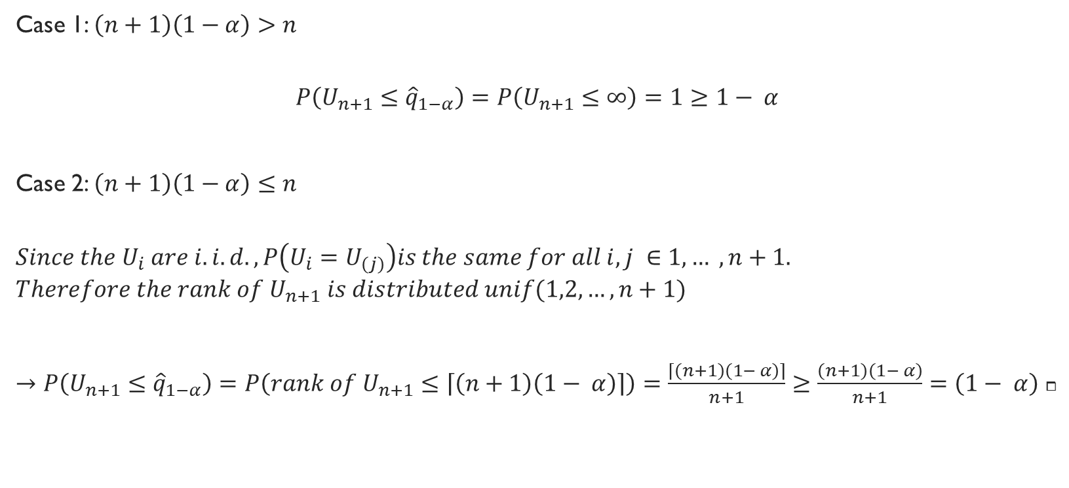
Proof:
Case 1: $\left(n+1\right)\left(1−α\right)>n$
$$P\left(U_{n+1}≤{\hat{q}}_{1−α}\right)=P\left(U_{n+1}≤∞\right)=1≥1− α$$
Case 2: $\left(n+1\right)\left(1−α\right)≤n$
$$Since the U_{i} are i.i.d., P\left(U_{i}=U_{\left(j\right)}\right)is the same for all i,j ∈1,… , n+1.$$
$$Therefore the rank of U_{n+1} is distributed unif(1,2,…,n+1)$$
$→P\left(U_{n+1}≤{\hat{q}}_{1−α}\right)=P\left(rank of U_{n+1}≤\left\lceil \left(n+1\right)\left(1− α\right)\right\rceil \right)=\frac{\left\lceil \left(n+1\right)\left(1− α\right)\right\rceil }{n+1}≥\frac{\left(n+1\right)\left(1− α\right)}{n+1}=\left(1− α\right)$ $⧠$

Slide 8
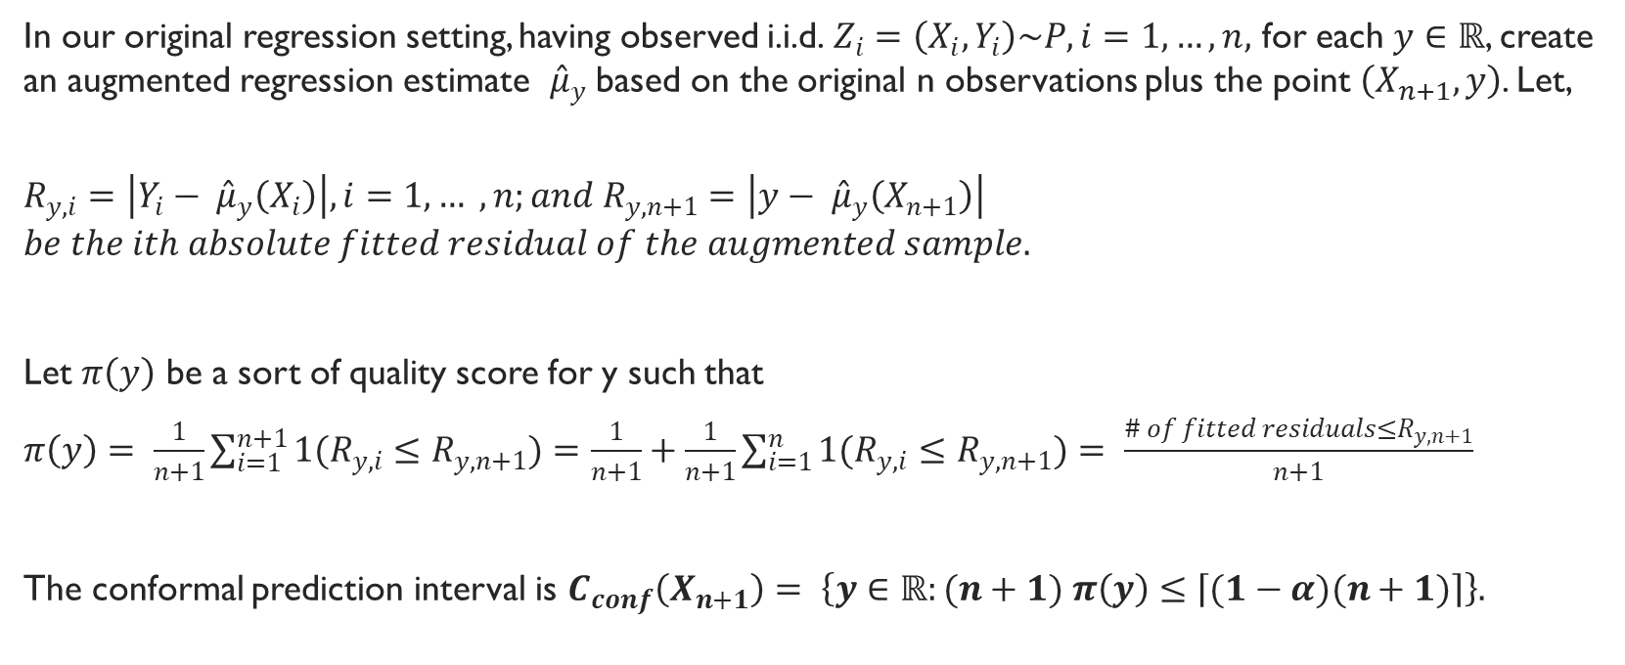
Full Conformal Prediction Interval
In our original regression setting, having observed i.i.d. $Z_{i}=\left(X_{i},Y_{i}\right)\sim P, i=1, …, n,$ for each $y∈ℝ$, create an augmented regression estimate ${\hat{μ}}_{y}$ based on the original n observations plus the point $\left(X_{n+1},y\right)$. Let,
$$R_{y,i}=\left|Y_{i}− {\hat{μ}}_{y}\left(X_{i}\right)\right|, i=1, … , n;and R_{y,n+1}=\left|y− {\hat{μ}}_{y}\left(X_{n+1}\right)\right|$$
$$be the ith absolute fitted residual of the augmented sample.$$
Let $π\left(y\right)$ be a sort of quality score for y such that
$π\left(y\right)= \frac{1}{n+1}\sum_{i=1}^{n+1}{1(R_{y,i}≤R_{y,n+1})}=\frac{1}{n+1}+\frac{1}{n+1}\sum_{i=1}^{n}{1(R_{y,i}≤R_{y,n+1})}= \frac{\# of fitted residuals≤R_{y,n+1}}{n+1}$
The conformal prediction interval is $C_{conf}\left(X_{n+1}\right)= \left\{y∈ℝ:(n+1) π\left(y\right)≤\left\lceil (1−α)(n+1)\right\rceil \right\}.$

Slide 9
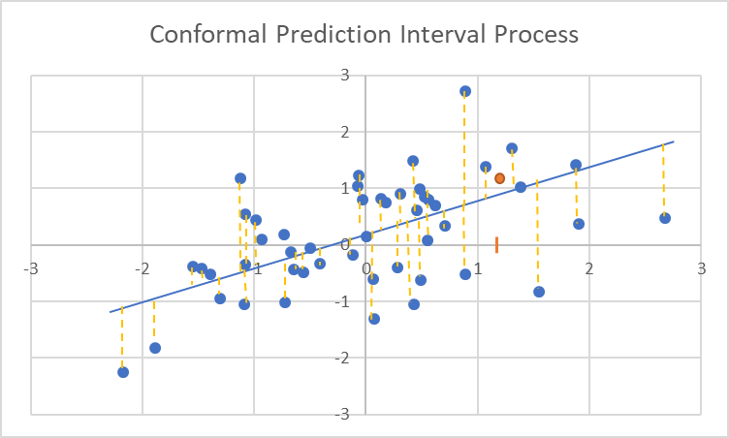

Full Conformal Prediction Interval
Suppose α = 0.05, intuitively this conformal prediction interval is constructed by first choosing a $y∈ℝ$, then deciding whether it is in the prediction interval by refitting the model under the assumption that Y_{n+1} = y. If the absolute residual associated with y, $R_{y,n+1}$, is not larger than approximately 95% of the of the other residuals, then include it in the interval. Then choose the next y-value, refit the model and perform the same evaluation, etc. Of course, this can’t be repeated for every $y∈ℝ$, so in practice a finite set of y-values is chosen to test.
Steps
1) Choose y (orange dot).
2) Fit model to data set including y.
3) Calculate all absolute residuals
4) Compare the residual of y to the other residuals.
5) Decide if y is in the interval
6) Pick another y and repeat.

Slide 10
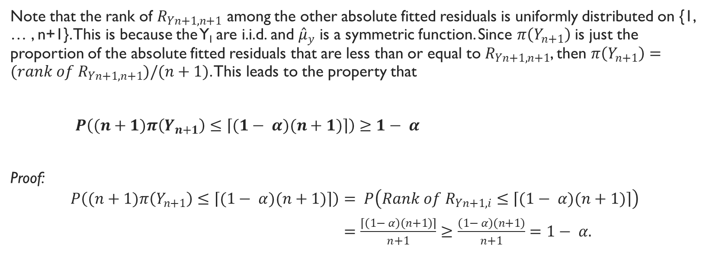
Another Preliminary Result (**)
Note that the rank of $R_{Yn+1,n+1}$ among the other absolute fitted residuals is uniformly distributed on {1, … , n+1}. This is because the Y­_{I} are i.i.d. and ${\hat{μ}}_{y}$ is a symmetric function. Since $π\left(Y_{n+1}\right)$ is just the proportion of the absolute fitted residuals that are less than or equal to $R_{Yn+1,n+1}$, then $π\left(Y_{n+1}\right)=(rank of R_{Yn+1,n+1})/(n+1)$. This leads to the property that
$P\left((n+1)π\left(Y_{n+1}\right)≤\left\lceil (1− α)(n+1)\right\rceil \right)≥1− α$
Proof:
$$P\left((n+1)π\left(Y_{n+1}\right)≤\left\lceil (1− α)(n+1)\right\rceil \right)= P\left(Rank of R_{Yn+1,i}≤\left\lceil (1− α)(n+1)\right\rceil \right)$$
$=\frac{\left\lceil \left(1− α\right)\left(n+1\right)\right\rceil }{n+1}≥\frac{\left(1− α\right)\left(n+1\right)}{n+1}=1− α.$

Slide 11
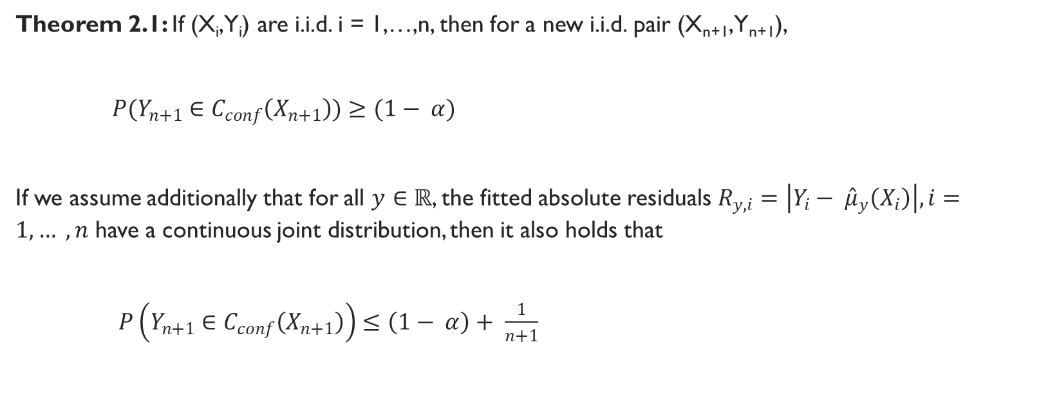
Full Conformal Average Coverage Property
Theorem 2.1: If (X_{i},Y_{i}) are i.i.d. i = 1,…,n, then for a new i.i.d. pair (X_{n+1},Y_{n+1}),
$P(Y_{n+1}∈C_{conf}\left(X_{n+1}\right))≥(1− α)$
If we assume additionally that for all $y∈ℝ$, the fitted absolute residuals $R_{y,i}=\left|Y_{i}− {\hat{μ}}_{y}\left(X_{i}\right)\right|, i=1, … , n$ have a continuous joint distribution, then it also holds that
$P\left(Y_{n+1}∈C_{conf}\left(X_{n+1}\right)\right)≤\left(1− α\right)+ \frac{1}{n+1}$

Slide 12
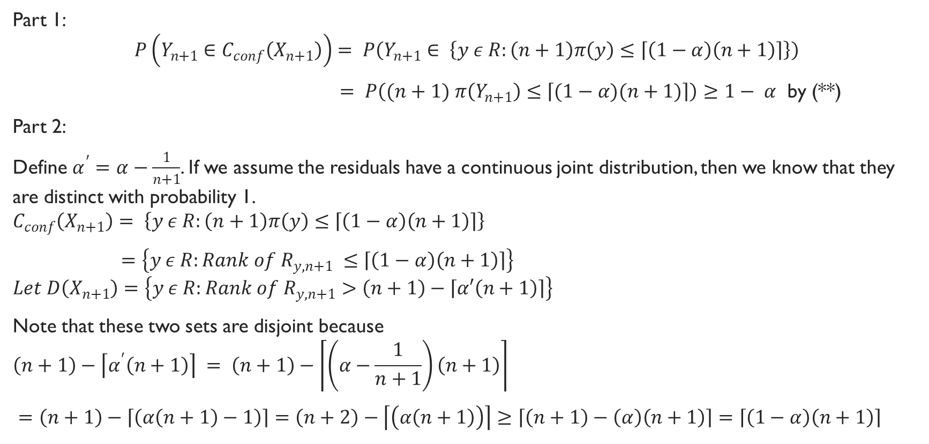
Proof:
Part 1:
$$P\left(Y_{n+1}∈C_{conf}\left(X_{n+1}\right)\right)= P\left(Y_{n+1}∈ \left\{y ε R:\left(n+1\right)π\left(y\right)≤\left\lceil \left(1−α\right)\left(n+1\right)\right\rceil \right\}\right)$$
$= P\left((n+1) π\left(Y_{n+1}\right)≤\left\lceil (1−α)(n+1)\right\rceil \right)≥1− α$ by (**)
Part 2:
Define $α^{′}=α−\frac{1}{n+1}$. If we assume the residuals have a continuous joint distribution, then we know that they are distinct with probability 1.
$$C_{conf}\left(X_{n+1}\right)= \left\{y ε R:\left(n+1\right)π\left(y\right)≤\left\lceil \left(1−α\right)\left(n+1\right)\right\rceil \right\}$$
$=\left\{y ε R:Rank of{ R}_{y,n+1} ≤\left\lceil \left(1−α\right)\left(n+1\right)\right\rceil \right\}$
$$Let D\left(X_{n+1}\right)=\left\{y ε R:Rank of{ R}_{y,n+1}>\left(n+1\right)−\left\lceil α′\left(n+1\right)\right\rceil \right\}$$
Note that these two sets are disjoint because
$$\left(n+1\right)−\left\lceil α^{′}\left(n+1\right)\right\rceil = \left(n+1\right)−\left\lceil \left(α−\frac{1}{n+1}\right)\left(n+1\right)\right\rceil$$
$=\left(n+1\right)−\left\lceil \left(α\left(n+1\right)−1\right)\right\rceil =\left(n+2\right)−\left\lceil \left(α\left(n+1\right)\right)\right\rceil ≥\left\lceil \left(n+1\right)−\left(α\right)\left(n+1\right)\right\rceil =\left\lceil \left(1−α\right)\left(n+1\right)\right\rceil$

Slide 13
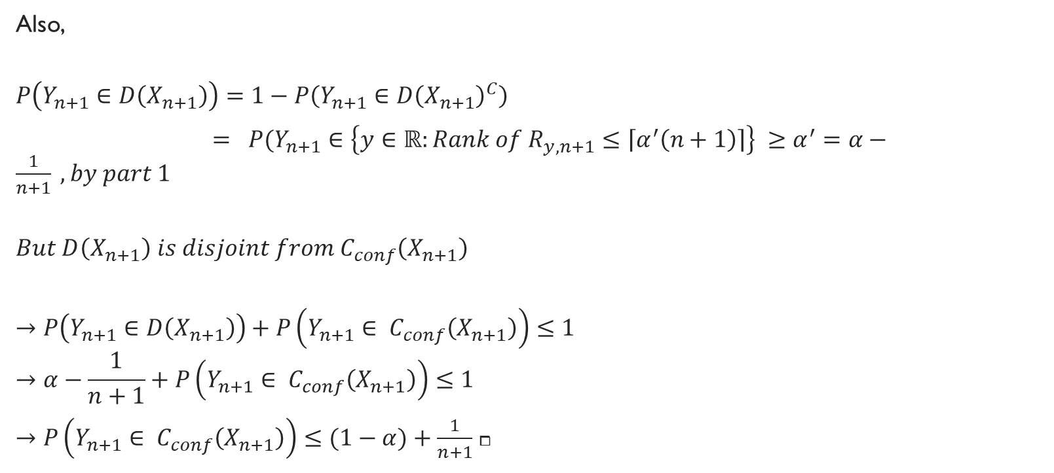
Proof Cont:
Also,
$$P\left(Y_{n+1}∈D\left(X_{n+1}\right)\right)=1−P\left(Y_{n+1}∈{D\left(X_{n+1}\right)}^{C}\right)$$
$= P(Y_{n+1}∈\left\{y∈ℝ:Rank of{ R}_{y,n+1}≤\left\lceil α^{′}\left(n+1\right)\right\rceil \right\} ≥α^{′}=α−\frac{1}{n+1} , by part 1$
$$But D\left(X_{n+1}\right) is disjoint from C_{conf}\left(X_{n+1}\right)$$
$$→P\left(Y_{n+1}∈D\left(X_{n+1}\right)\right)+P\left(Y_{n+1}∈ C_{conf}\left(X_{n+1}\right)\right)≤1$$
$$→α−\frac{1}{n+1}+P\left(Y_{n+1}∈ C_{conf}\left(X_{n+1}\right)\right)≤1$$
$→P\left(Y_{n+1}∈ C_{conf}\left(X_{n+1}\right)\right)≤(1−α)+\frac{1}{n+1}$ $⧠$

Slide 14
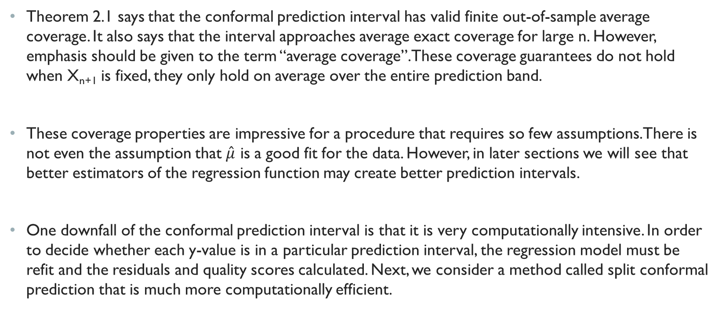
Full Conformal Prediction Interval
Theorem 2.1 says that the conformal prediction interval has valid finite out-of-sample average coverage. It also says that the interval approaches average exact coverage for large n. However, emphasis should be given to the term “average coverage”. These coverage guarantees do not hold when X_{n+1} is fixed, they only hold on average over the entire prediction band.
These coverage properties are impressive for a procedure that requires so few assumptions. There is not even the assumption that $\hat{μ}$ is a good fit for the data. However, in later sections we will see that better estimators of the regression function may create better prediction intervals.
One downfall of the conformal prediction interval is that it is very computationally intensive. In order to decide whether each y-value is in a particular prediction interval, the regression model must be refit and the residuals and quality scores calculated. Next, we consider a method called split conformal prediction that is much more computationally efficient.

Slide 15
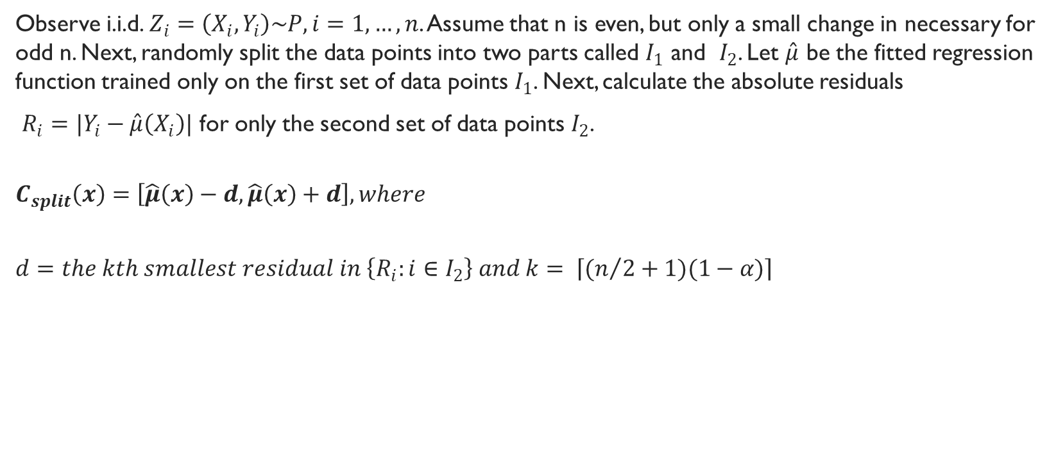
Split Conformal Prediction Interval
Observe i.i.d. $Z_{i}=\left(X_{i},Y_{i}\right)\sim P, i=1, …, n$. Assume that n is even, but only a small change in necessary for odd n. Next, randomly split the data points into two parts called $I_{1}$ and $I_{2}$. Let $\hat{μ}$ be the fitted regression function trained only on the first set of data points $I_{1}$. Next, calculate the absolute residuals
$R_{i}=|Y_{i}−\hat{μ}\left(X_{i}\right)|$ for only the second set of data points $I_{2}$.
$$C_{split}\left(x\right)=\left[\hat{μ}\left(x\right)−d,\hat{μ}\left(x\right)+d\right], where$$
$$d=the kth smallest residual in \left\{R_{i}:i∈I_{2}\right\} and k= \left\lceil (n/2+1)(1−α)\right\rceil$$

Slide 16

split Conformal Average Coverage Property
Theorem 2.2: If $\left(X_{i},Y_{i}\right), i=1, …, n$ are i.i.d., then for a new i.i.d. draw $\left(X_{n+1},Y_{n+1}\right)$,
$P(Y_{n+1}∈C_{split}\left(X_{n+1}\right))≥(1− α)$
Further, if we assume the $\left\{R_{i}:i∈I_{2}\right\}$ have a continuous joint distribution then
$P(Y_{n+1}∈C_{split}\left(X_{n+1}\right))≤\left(1− α\right)+ \frac{2}{n+2}$

Slide 17
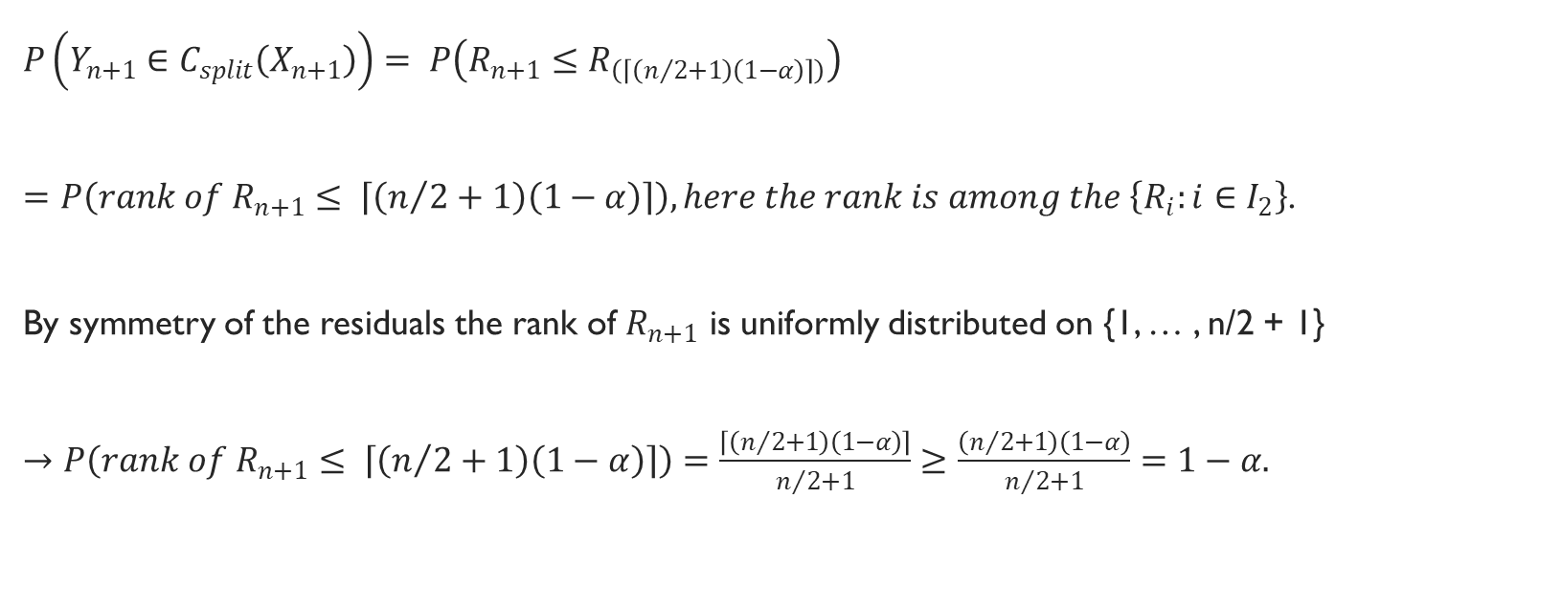
Proof part 1:
$$P\left(Y_{n+1}∈C_{split}\left(X_{n+1}\right)\right)= P\left(R_{n+1}≤R_{\left(\left\lceil \left(n/2+1\right)\left(1−α\right)\right\rceil \right)}\right)$$
$=P\left(rank of R_{n+1}≤ \left\lceil \left(n/2+1\right)\left(1−α\right)\right\rceil \right), here the rank is among the \left\{R_{i}:i∈I_{2}\right\}$.
By symmetry of the residuals the rank of $R_{n+1}$ is uniformly distributed on {1, … , n/2 + 1}
$→P\left(rank of R_{n+1}≤ \left\lceil \left(n/2+1\right)\left(1−α\right)\right\rceil \right)=\frac{\left\lceil \left(n/2+1\right)\left(1−α\right)\right\rceil }{n/2+1}≥\frac{\left(n/2+1\right)\left(1−α\right)}{n/2+1}=1−α.$
Notes:
This part follows from very similar logic as for the full conformal interval.

Slide 18
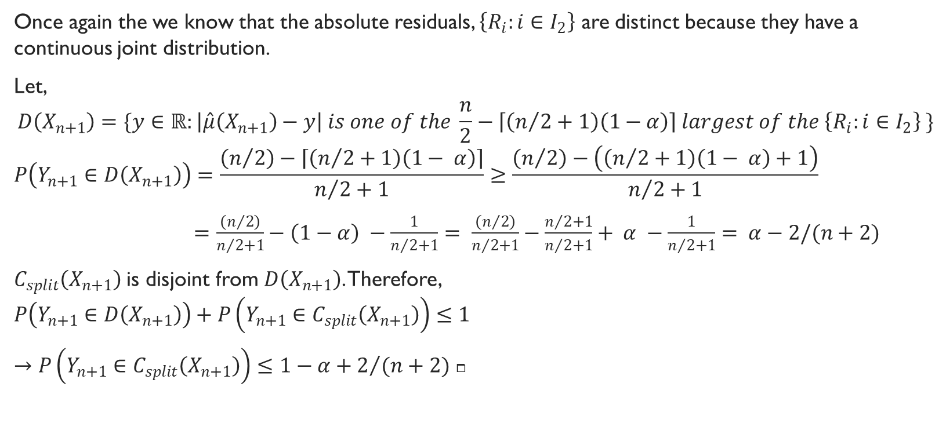
Proof part 2:
Once again the we know that the absolute residuals, $\left\{R_{i}:i∈I_{2}\right\}$ are distinct because they have a continuous joint distribution.
Let,
$$D\left(X_{n+1}\right)=\{y∈ℝ:\left|\hat{μ}\left(X_{n+1}\right)−y\right| is one of the \frac{n}{2}−\left\lceil \left(n/2+1\right)\left(1−α\right)\right\rceil largest of the \left\{R_{i}:i∈I_{2}\right\} \}$$
$$P\left(Y_{n+1}∈D\left(X_{n+1}\right)\right)=\frac{\left(n/2\right)−\left\lceil \left(n/2+1\right)\left(1− α\right)\right\rceil }{n/2+1}≥\frac{\left(n/2\right)−\left(\left(n/2+1\right)\left(1− α\right)+1\right)}{n/2+1}$$
$=\frac{\left(n/2\right)}{n/2+1}−\left(1−α\right) −\frac{1}{n/2+1}= \frac{\left(n/2\right)}{n/2+1}−\frac{n/2+1}{n/2+1}+ α −\frac{1}{n/2+1}= α−2/(n+2)$
$C_{split}\left(X_{n+1}\right)$is disjoint from $D\left(X_{n+1}\right)$. Therefore,
$$P\left(Y_{n+1}∈D\left(X_{n+1}\right)\right)+P\left(Y_{n+1}∈C_{split}\left(X_{n+1}\right)\right)≤1$$
$→P\left(Y_{n+1}∈C_{split}\left(X_{n+1}\right)\right)≤1−α+2/{(n+2)}$ $⧠$

Slide 19
Split Conformal Prediction Interval
Theorem 2.2 says that the split conformal prediction interval has finite out-of-sample average coverage and approaches average exact coverage for large n.
Additionally, this method has much faster computation because it does not re-fit the model multiple times. This is especially important for modeling procedures that involve automatic variable selection. It is also valid under the same assumptions as the full conformal method.
The downside of split conformal prediction as will be seen in the simulations section is that it does not create as short intervals as the full conformal method.

Slide 20
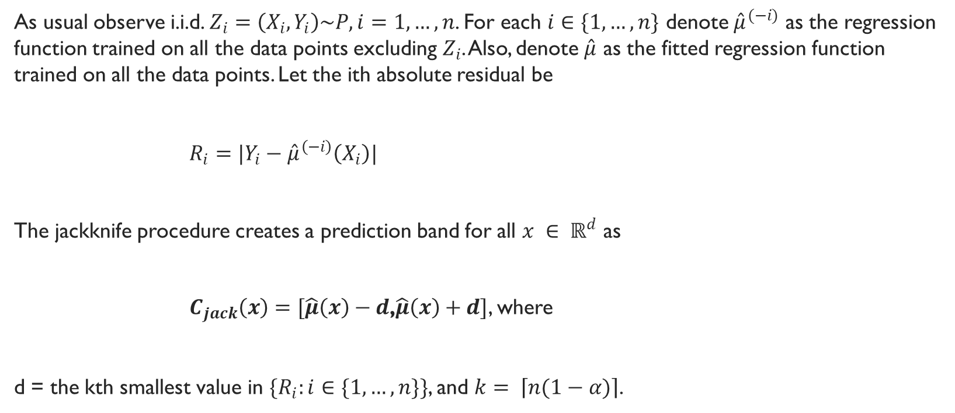
Jackknife Prediction Interval
As usual observe i.i.d. $Z_{i}=\left(X_{i},Y_{i}\right)\sim P, i=1, …, n$. For each $i∈\{1, …, n\}$ denote ${\hat{μ}}^{(−i)}$ as the regression function trained on all the data points excluding $Z_{i}$. Also, denote $\hat{μ}$ as the fitted regression function trained on all the data points. Let the ith absolute residual be
$R_{i}=|Y_{i}−{\hat{μ}}^{\left(−i\right)}\left(X_{i}\right)|$
The jackknife procedure creates a prediction band for all $x ∈ ℝ^{d}$ as
$C_{jack}\left(x\right)=[\hat{μ}\left(x\right)−d$,$\hat{μ}\left(x\right)+d]$, where
d = the kth smallest value in $\{R_{i}:i∈\{1, …, n\}\}$, and $k= \left\lceil n(1−α)\right\rceil$.
Notes:
In the jackknife procedure, for each data point the regression model is fit excluding that data point, and then the residual is calculated for that data point only. The prediction interval is again symmetric around the estimator with the length based on the residual distribution as described below. Since the model is fit using more of the data points, this method tends to result in shorter intervals than the split conformal method.

Slide 21
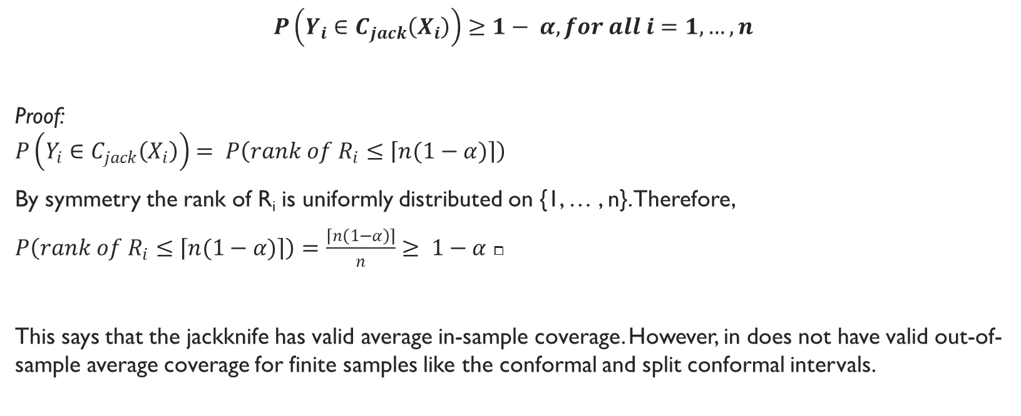
Jackknife In-Sample Average Coverage
$$P\left(Y_{i}∈C_{jack}\left(X_{i}\right)\right)≥1− α, for all i=1, …, n$$
Proof:
$$P\left(Y_{i}∈C_{jack}\left(X_{i}\right)\right)= P\left(rank of R_{i}≤\left\lceil n(1−α)\right\rceil \right)$$
By symmetry the rank of R_{i} is uniformly distributed on {1, … , n}. Therefore,
$P\left(rank of R_{i}≤\left\lceil n(1−α)\right\rceil \right)=\frac{\left\lceil n\left(1−α\right)\right\rceil }{n}≥ 1−α$ $⧠$
This says that the jackknife has valid average in-sample coverage. However, in does not have valid out-of-sample average coverage for finite samples like the conformal and split conformal intervals.

Slide 22
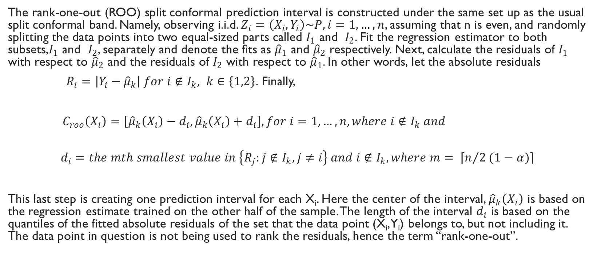
Rank-One-Out Split Conformal Interval
The rank-one-out (ROO) split conformal prediction interval is constructed under the same set up as the usual split conformal band. Namely, observing i.i.d. $Z_{i}=\left(X_{i},Y_{i}\right)\sim P, i=1, …, n$, assuming that n is even, and randomly splitting the data points into two equal-sized parts called $I_{1}$ and $I_{2}$. Fit the regression estimator to both subsets,$I_{1}$ and $I_{2}$, separately and denote the fits as ${\hat{μ}}_{1}$ and ${\hat{μ}}_{2}$ respectively. Next, calculate the residuals of $I_{1}$ with respect to ${\hat{μ}}_{2}$ and the residuals of $I_{2}$ with respect to ${\hat{μ}}_{1}$. In other words, let the absolute residuals
$R_{i}=\left|Y_{i}−{\hat{μ}}_{k}\right| for i∉I_{k}, k∈\left\{1,2\right\}.$ Finally,
$C_{roo}\left(X_{i}\right)=\left[{\hat{μ}}_{k}\left(X_{i}\right)−d_{i},{\hat{μ}}_{k}\left(X_{i}\right)+d_{i}\right], for i=1, …, n, where i∉I_{k} and$
$$d_{i}=the mth smallest value in \left\{R_{j}:j∉I_{k}, j≠i\right\} and i∉I_{k}, where m= \left\lceil n/2(1−α)\right\rceil$$
This last step is creating one prediction interval for each X_{i}. Here the center of the interval, ${\hat{μ}}_{k}\left(X_{i}\right)$ is based on the regression estimate trained on the other half of the sample. The length of the interval $d_{i}$ is based on the quantiles of the fitted absolute residuals of the set that the data point (X_{i},Y_{i}) belongs to, but not including it. The data point in question is not being used to rank the residuals, hence the term “rank-one-out”.
Notes:
As mentioned split and full conformal bands do not have valid in-sample coverage. We do already have one method, the Jackknife with this property, but it’s notable that we can adjust the split conformal method if this property is desired.

Slide 23
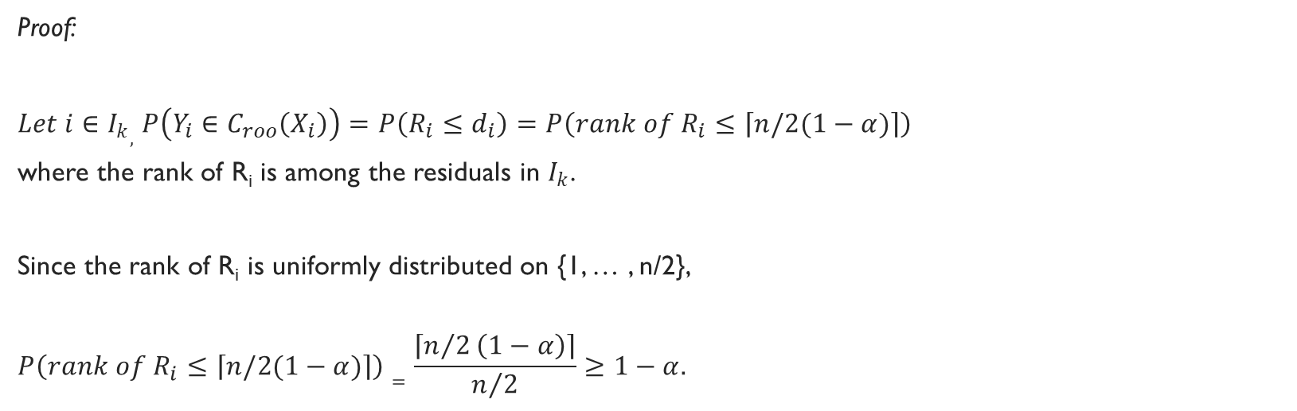
Rank-One-Out In-Sample average coverage
$$P\left(Y_{i}∈C_{roo}\left(X_{i}\right)\right)≥1− α, for all i=1, …, n$$
Proof:
$Let i∈I_{k},$ $P\left(Y_{i}∈C_{roo}\left(X_{i}\right)\right)=P\left(R_{i}≤d_{i}\right)=P\left(rank of R_{i}≤\left\lceil n/2(1−α)\right\rceil \right)$
where the rank of R_{i} is among the residuals in $I_{k}$.
Since the rank of R_{i} is uniformly distributed on {1, … , n/2},
$$P\left(rank of R_{i}≤\left\lceil n/2(1−α)\right\rceil \right)=\frac{\left\lceil n/2\left(1−α\right)\right\rceil }{n/2}≥1−α.$$

Slide 24
Additional coverage Results
The full and spit conformal interval have valid conditional coverage for large n under certain assumptions including consistency and an error distribution that is symmetric about zero and non-increasing on [0, infinity).
Elaboration on these conditions is excluded for brevity, but in the following simulations we will see that the estimator may be an important factor in the length of the interval.

Slide 25
simulations
Simulations are performed across three different simulation setting for low dimensional and high dimensional data and across a variety of regression estimators. In every case α is chosen to be 0.1.
Conformal Prediction, Jackknife, and Split Conformal intervals are compared as well as the classical parametric interval from linear regression where appropriate.

Slide 26
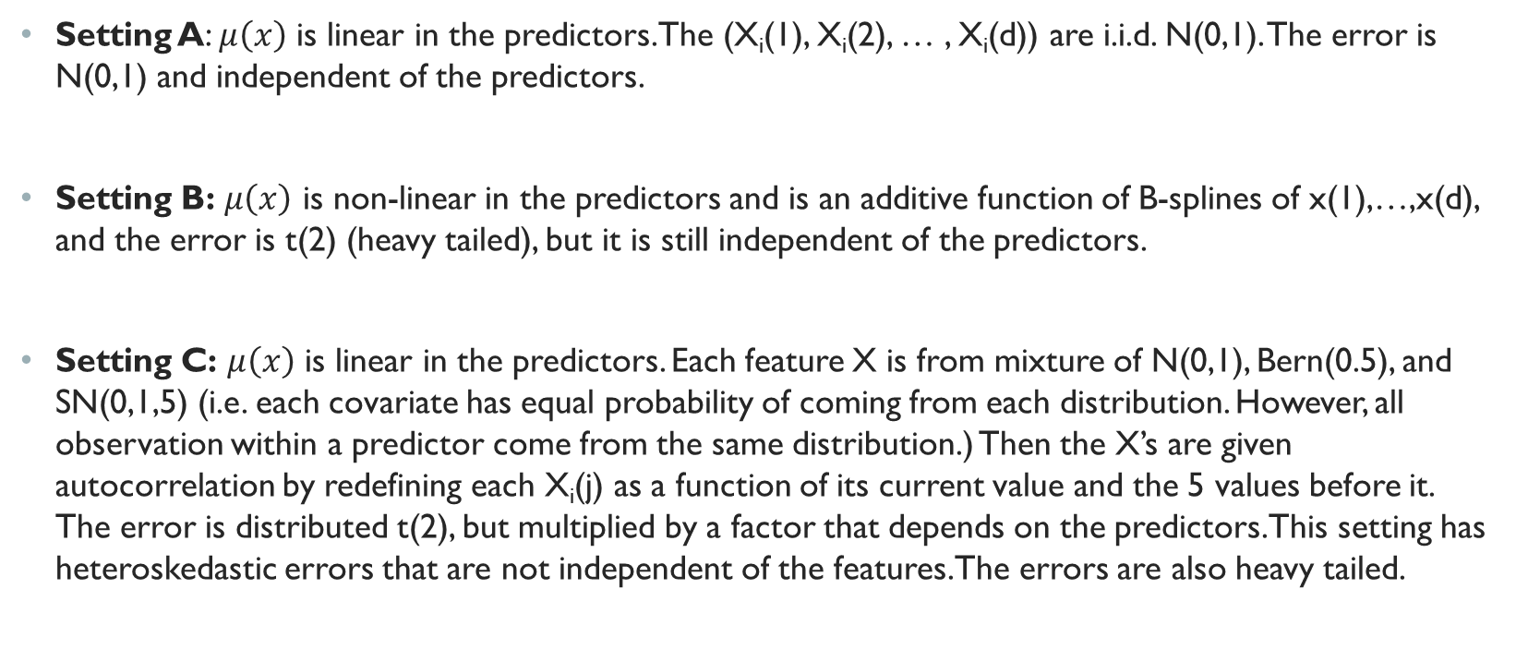
Simulation settings
Setting A: $μ\left(x\right)$ is linear in the predictors. The (X_{i}(1), X_{i}(2), … , X_{i}(d)) are i.i.d. N(0,1). The error is N(0,1) and independent of the predictors.
Setting B: $μ\left(x\right)$ is non-linear in the predictors and is an additive function of B-splines of x(1),…,x(d), and the error is t(2) (heavy tailed), but it is still independent of the predictors.
Setting C: $μ\left(x\right)$ is linear in the predictors. Each feature X is from mixture of N(0,1), Bern(0.5), and SN(0,1,5) (i.e. each covariate has equal probability of coming from each distribution. However, all observation within a predictor come from the same distribution.) Then the X’s are given autocorrelation by redefining each X_{i}(j) as a function of its current value and the 5 values before it. The error is distributed t(2), but multiplied by a factor that depends on the predictors. This setting has heteroskedastic errors that are not independent of the features. The errors are also heavy tailed.

Slide 27
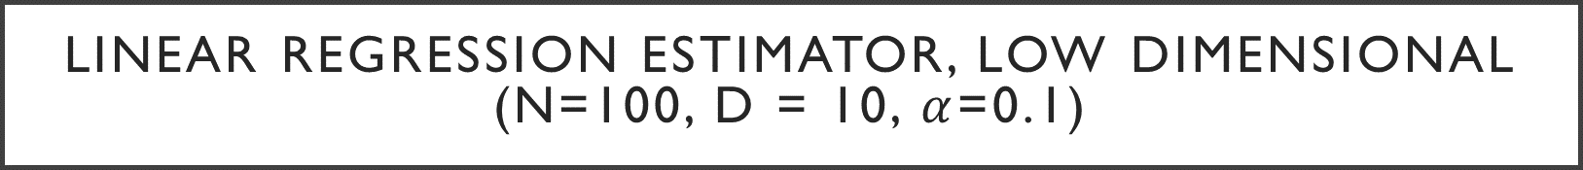
Linear Regression Estimator, low dimensional (n=100, d = 10, $α$=0.1)
Setting A
 | Conformal | Jackknife | Split | Parametric
Coverage | 0.903 (0.006) | 0.888 (0.007) | 0.913 (0.006) | 0.903 (0.006)
Length | 3.541 (0.059) | 3.412 (0.056) | 3.854 (0.075) | 3.512 (0.047)
Time | 0.861 | 0.009 | 0.001 | 0.001
All intervals have close to exact average coverage.
Jackknife is the shortest, but also has less coverage.
Conformal is good, but slow.
Setting B
 | Conformal | Jackknife | Split | Parametric
Coverage | 0.906 (0.005) | 0.897 (0.005) | 0.9 (0.008) | 0.915 (0.006)
Length | 9.521 (0.17) | 9.189 (0.158) | 10.394(0.288) | 10.386(0.411)
Time | 0.868 | 0.012 | 0 | 0.003
Similar to setting A, but conformal is better than parametric.
Conformal methods have best length and almost exact average coverage even though model is mispecified,
Setting C
 | Conformal | Jackknife | Split | Parametric
Coverage | 0.907 (0.006) | 0.896 (0.006) | 0.91 (0.007) | 0.95 (0.005)
Length | 23.457(2.093) | 22.102(2.017) | 27.732(2.938) | 39.892(4.946)
Time | 0.867 | 0.011 | 0 | 0.002
Parametric seems to over-cover.
Split conformal remains larger than conformal, but faster.
Jackknife is shortest and doesn’t have average coverage guarantee.
Notes:
Number of new points to predict = 100
Time in seconds
Coverage and Length are averages over the 100 new observations.

Slide 28

Linear Regression Estimator, high dimensional (n=500, d = 490, $α$=0.1)
Setting A
 | Conformal | Jackknife | Parametric
Coverage | 0.914 (0.011) | 0.901 (0.014) | 0.919 (0.014)
Length | 8.654 (0.139) | 27.359(0.955) | 28.255(0.907)
Time | 59.396 | 71.062 | 0.372
Conformal has much better length while maintaining valid coverage.
The only downside is time.
This is true across all settings.
Setting B
 | Conformal | Jackknife | Parametric
Coverage | 0.885 (0.013) | 0.866 (0.015) | 0.887 (0.014)
Length | 53.932(4.005) | 78.962(4.488) | 81.468 (4.84)
Time | 55.715 | 64.441 | 0.331
Setting C
 | Conformal | Jackknife | Parametric
Coverage | 0.907 (0.012) | 0.895 (0.017) | 0.908 (0.016)
Length | 214.082 (14.185) | 263.686 (15.594) | 271.479 (15.675)
Time | 51.906 | 63.153 | 0.314

Slide 29
Comparison Of Estimators
Computation Time (s) Full Conformal Low Dim (N = 200, D = 20, S = 5)
 | Lasso | Elastic Net | SPAM | Rand. Forest | Forw. Step
Setting A | 58.3 | 58.05 | 643.02 | 3818.01 | 37.19
Setting B | 57.72 | 58.08 | 569.69 | 3554.7 | 37.27
Setting C | 67.95 | 69.28 | 2487.26 | 4814.27 | 41.13
Full Conformal computation time could be prohibitive even in low dimensions and especially in high dimensions, but also depends on estimator.
Time is in seconds.
Computation Time (s) Full Conformal High Dim (N = 200, D = 2000, S = 5)
 | Lasso | Elastic Net | Forw. Step
Setting A | 501.31 | 490.18 | 1778.68
Setting B | 525.1 | 498.07 | 1971.78
Setting C | 506.45 | 527.35 | 1988.07

Slide 30
Comparison Of Estimators
Split Conformal Low Dimensional – Coverage nearly exact, length possibly related to test error, not in all settings.
Split Conformal Interval Low Dim (n = 200, d =20, s = 5)
Method | Coverage | Test Error | Length | Setting
Lasso | 0.91 | 1.065 | 3.527 | A
Elastic Net | 0.907 | 1.063 | 3.509 | A
SPAM | 0.907 | 1.117 | 3.615 | A
Random For | 0.904 | 1.111 | 3.588 | A
Forw Step | 0.908 | 1.125 | 3.62 | A
Lasso | 0.894 | 10.169 | 7.483 | B
Elastic Net | 0.902 | 9.96 | 7.537 | B
SPAM | 0.892 | 9.734 | 7.022 | B
Random For | 0.901 | 9.902 | 7.462 | B
Forw Step | 0.89 | 10.247 | 7.431 | B
Lasso | 0.899 | 98.912 | 15.884 | C
Elastic Net | 0.904 | 99.056 | 15.864 | C
SPAM | 0.894 | 112.803 | 15.746 | C
Random For | 0.903 | 107.1 | 18.709 | C
Forw Step | 0.903 | 99.459 | 15.532 | C

Slide 31
Comparison Of Estimators
Split Conformal High Dimensional – Coverage nearly exact, length possibly related to test error, not in all settings.
Split Conformal Interval High Dim (n=200, d = 2000, s = 5)
Method | Coverage | Test Er | Length | Time | Setting
Lasso | 0.897 | 1.160 | 3.583 | 0.048 | A
Elastic Net | 0.900 | 1.157 | 3.623 | 0.045 | A
SPAM | 0.908 | 1.156 | 3.716 | 5.442 | A
Random F | 0.903 | 1.159 | 3.640 | 17.789 | A
Forw Step | 0.904 | 1.161 | 3.664 | 0.135 | A
Lasso | 0.908 | 8.895 | 8.362 | 0.064 | B
Elastic Net | 0.905 | 8.764 | 8.139 | 0.063 | B
SPAM | 0.911 | 8.674 | 8.211 | 6.945 | B
Random F | 0.907 | 8.720 | 8.243 | 24.644 | B
Forw Step | 0.904 | 9.104 | 8.403 | 0.194 | B
Lasso | 0.914 | 132.530 | 16.864 | 0.050 | C
Elastic Net | 0.914 | 132.536 | 16.549 | 0.055 | C
SPAM | 0.909 | 126.660 | 15.887 | 2.965 | C
Random F | 0.905 | 137.604 | 17.774 | 29.145 | C
Forw Step | 0.906 | 132.286 | 16.139 | 0.154 | C

Slide 32
R Package Used
R package is called conformalInference
Package has built in functions for all these prediction intervals and very good documentation. https://github.com/ryantibs/conformal

Slide 33
Conclusions
Prediction Interval | When to use
Full Conformal | Use to predict a new response corresponding to a new out-of-sample feature level. Can be used when the distribution of the data is unknown and may be used with any symmetric estimator. This method seems to create short prediction intervals and has nearly exact coverage across many settings, but has a high computational cost.
Split Conformal | Can be used in the same setting as full conformal, but creates larger intervals. Use when shorter computational time is needed.
Jackknife | The method takes more time than the split conformal. It creates very short intervals in low dimensional setting, but significantly larger intervals than the conformal in high dimensions. It does not have a valid out-of-sample coverage.
Rank-One-Out | Use as an alternative to the jackknife when in-sample valid coverage is desired.
Parametric | In the simulations parametric intervals were never optimal. However as expected they performed best when the assumptions of classical linear regression are met as in setting A. They were somewhat robust to departures in assumptions in the low dimensional setting, but very ineffective in the high dimensional setting even when assumptions were met.
Notes:
Conformal prediction creates valid intervals even when the model is misspecified and seems to perform better with better estimators, however it comes at a high computational cost.

Slide 34
References
Kutner, Michael, Applied Linear Regression Models Fourth Edition, New York, NY, McGraw-Hill Irwin, 2004, Print.
Gyorfi, Laszlo, et al., “A distribution-free theory of non-parametric regression”, Stanford University, http://web.stanford.edu/class/ee378a/books/book1.pdf
Weisstein, Eric W. "Symmetric Function." From MathWorld--A Wolfram Web Resource. http://mathworld.wolfram.com/SymmetricFunction.html
Mohri, Mehryar, Foundations of Machine Learning, MIT Press 2012, Digital.
Lei Et al., Distribution-Free Predictive Inference for Regression, Journal of the American Statistical Association, April 2017.
Full Conformal Interval R Code Source https://github.com/ryantibs/conformal/blob/master/conformalInference/R/full.R
Jackknife Interval R Code Source https://github.com/ryantibs/conformal/blob/master/conformalInference/R/jack.R
Split Conformal Interval R Code Source https://github.com/ryantibs/conformal/blob/master/conformalInference/R/split.R
ConformalInference R Package Documentation https://github.com/ryantibs/conformal/blob/master/conformalInference.pdf
Lei-Wasserman , “Distribution-free predictions bands for non-parametric regression” Carnagie Mellon University, 2014,
http://www.stat.cmu.edu/~ryantibs/statml/lectures/Lei-Wasserman.pdf
Weisstein, Eric W. "Markov's Inequality." From MathWorld--A Wolfram Web Resource. http://mathworld.wolfram.com/MarkovsInequality.html

